Slide 1
Questions?
Overview
Features
Wireframe
Diagrams

Slide 2
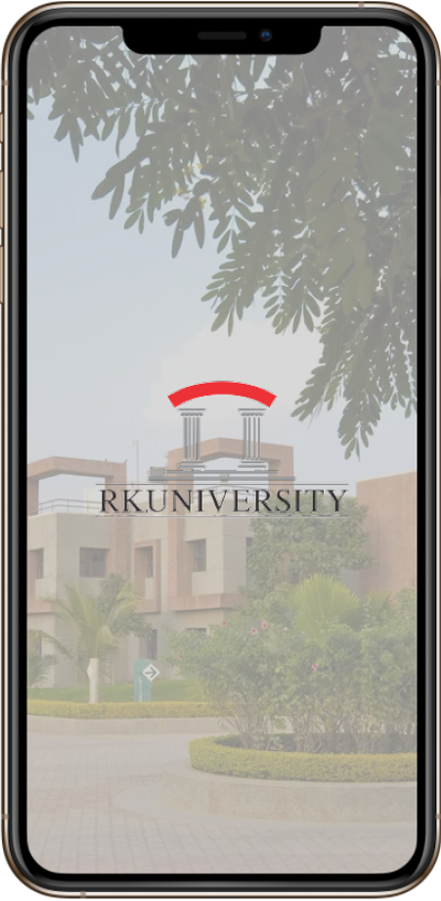
RKU Hostel Management App
Presented by-
Jatin Nabhoya 20SOECE11049
Meet Mangukiya 20SOECE11046
Priyal Sagar 20SOECE11062
Niti Bhanvadia 20SOECE11005

Slide 3
Table Of Contents
01
02
03
04
Work Distribution
Need of Project
Survey
Problem Statement
05
06
07
08
Features
Wireframes
Diagrams
Future Enhancement

Slide 4
Work Distribution
01
Sr no | Name | Work Done
1. | Jatin Nabhoya | Android layout, Figma Design, Diagrams
2. | Meet Mangukiya | Back end
3. | Niti Bhanvadia | SRS, Flow chart
4. | Priyal SAgar | PPT, Figma design, Diagrams

Slide 5
Why we choose this App??
02
We choose creating RKU HMS because Hostels are having problem in managing their hostel management system, so the hostels are in need of app which can provide them their own customizations in their hostel management system.

Slide 6
We analyse our users by passing google form and found what they want in our app and likewise we customized our app
03
So once the thought of HMS strike through our mind and then we figure out whether the people are really in need of this app by creating a analysis google form
https://forms.gle/yMV9x9uTzK3xG1jk6
Link to visit our google form

Slide 7
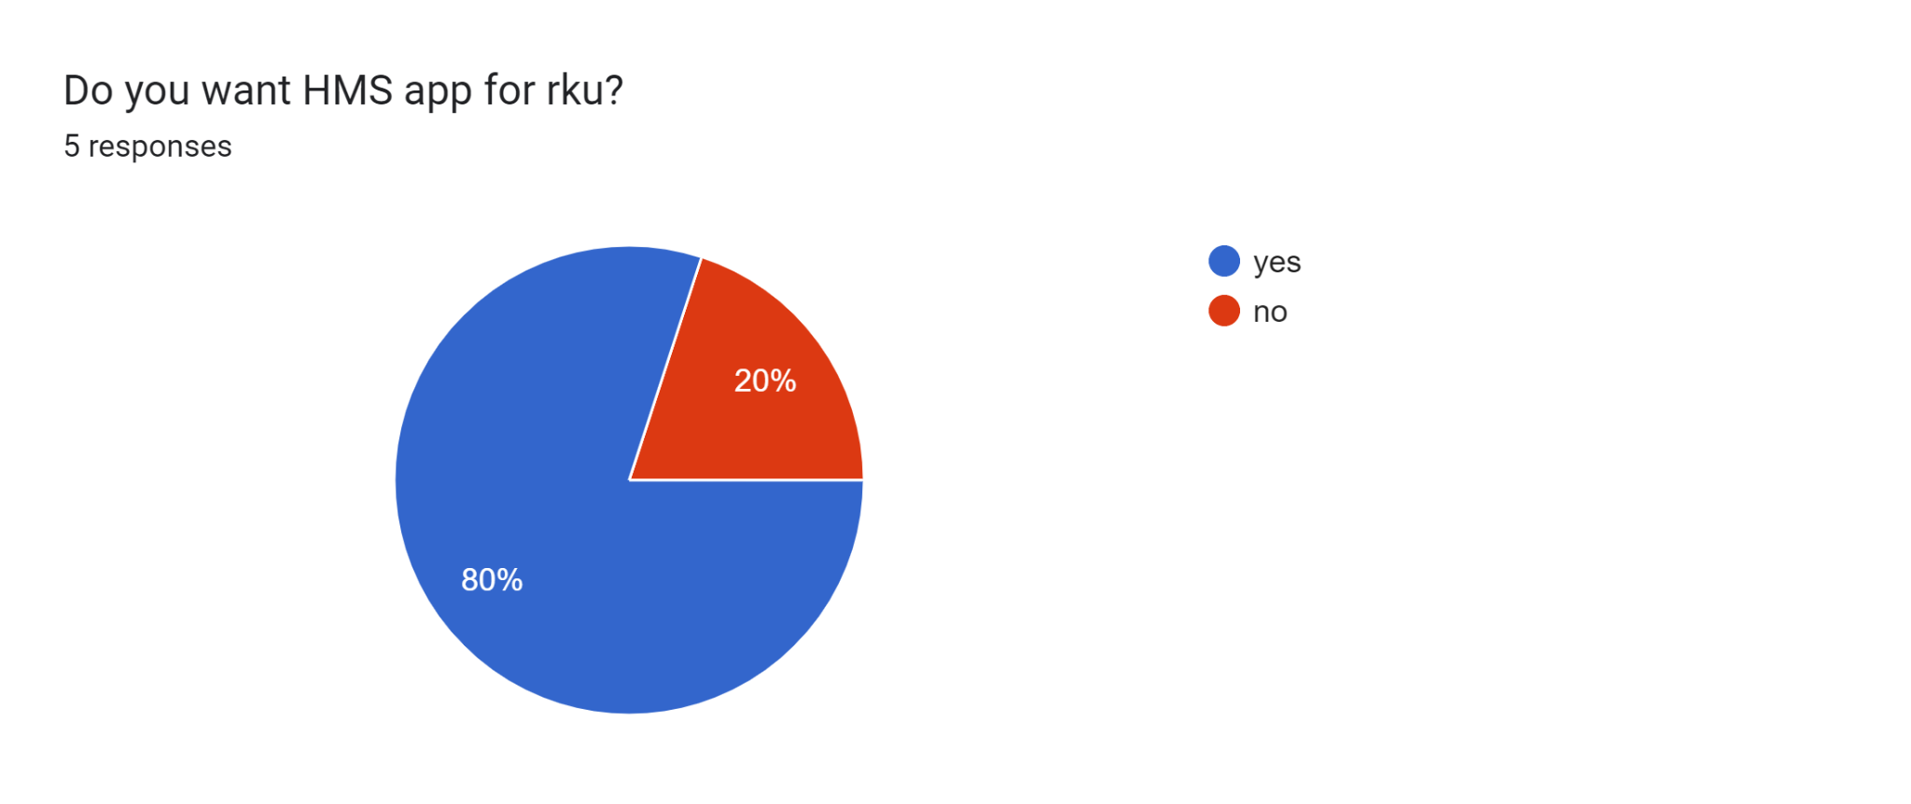
This is the response when we asked them if they want app like HMS for RKU
1
69 responses

Slide 8
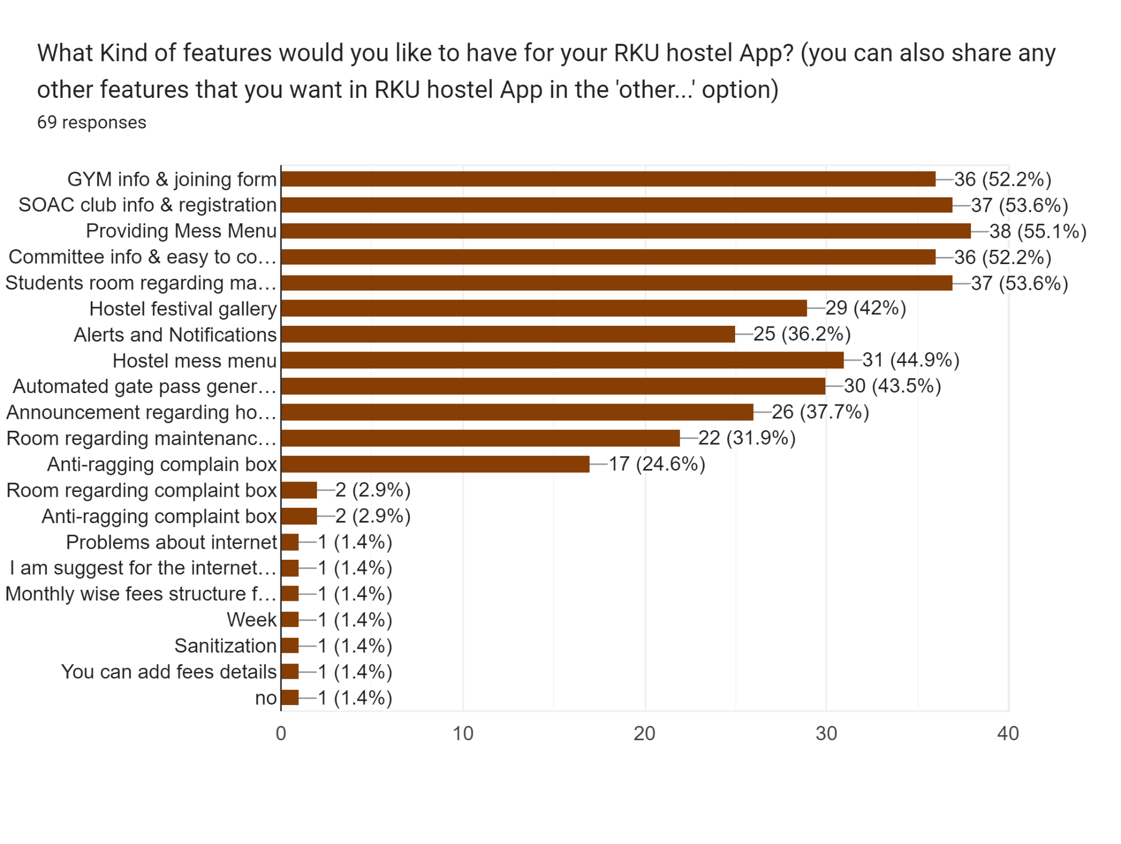
This is the response we get when we asked them what kind of features they want in it
Users are constantly searching for a solution

Slide 9
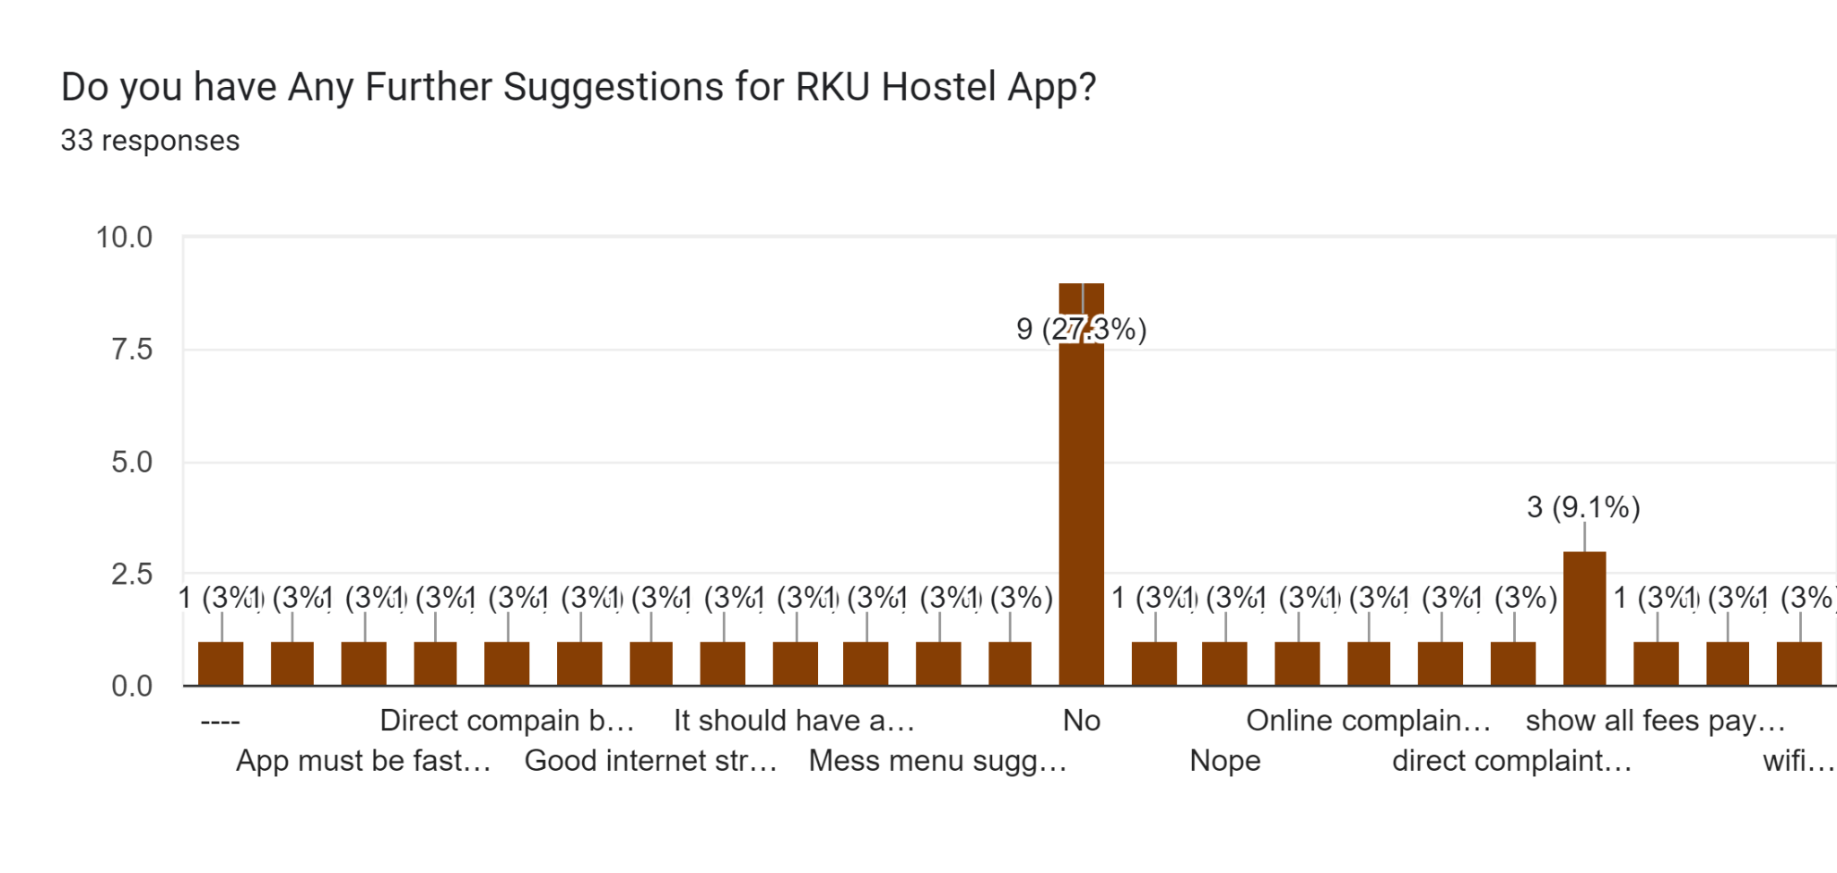
This is the response we get when we asked them for any further suggestions

Slide 10
Problem statement
So this is how we found our problem statement and started working on it according to the users of our app by asking them through the help of google form
And then we started working on RKU HMS app

Slide 11
Features
So by this analysis we figured out to provide the following features in our RKU HMS application -
GYM info & joining form
SOAC club info & registration
Providing Mess Menu
Committee info & easy to contact committee members
Students can complain
Warden can announce regarding any events,etc.

Slide 12
Wireframes

Slide 13
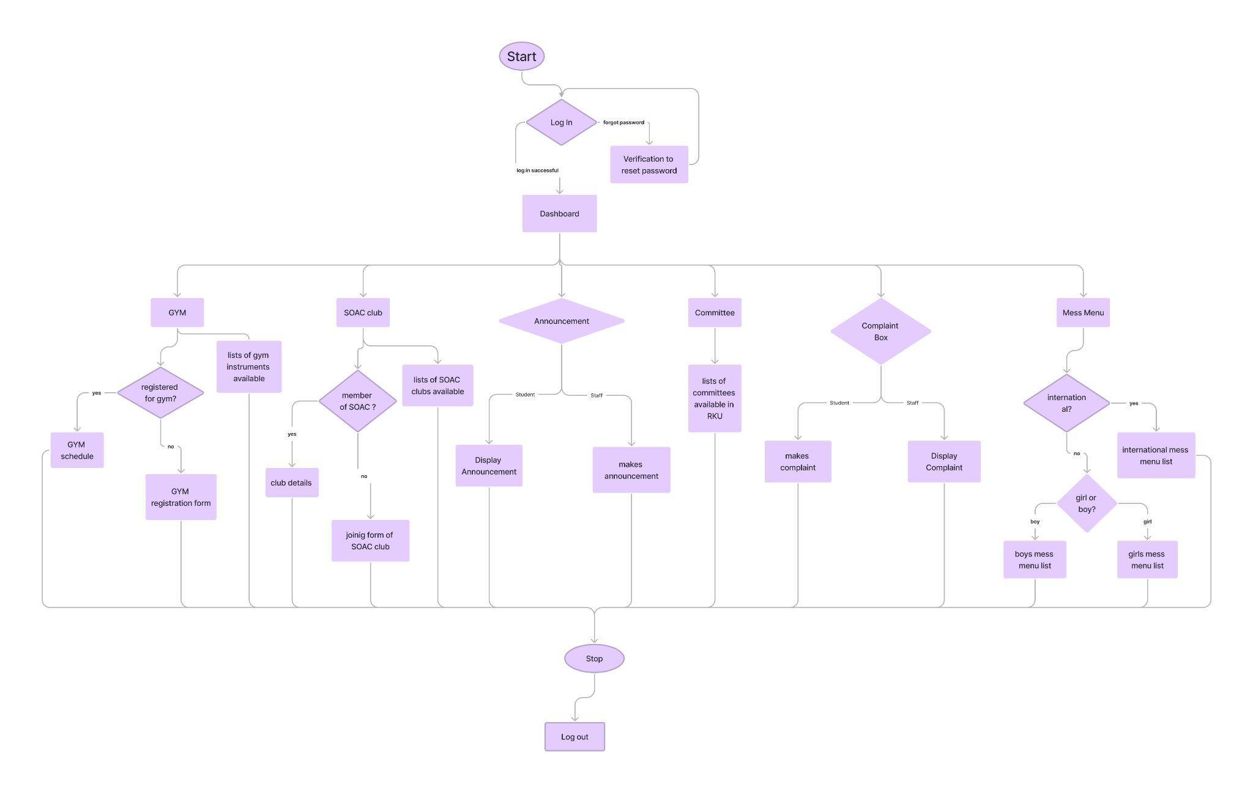
RKU HMS architecture

Slide 14
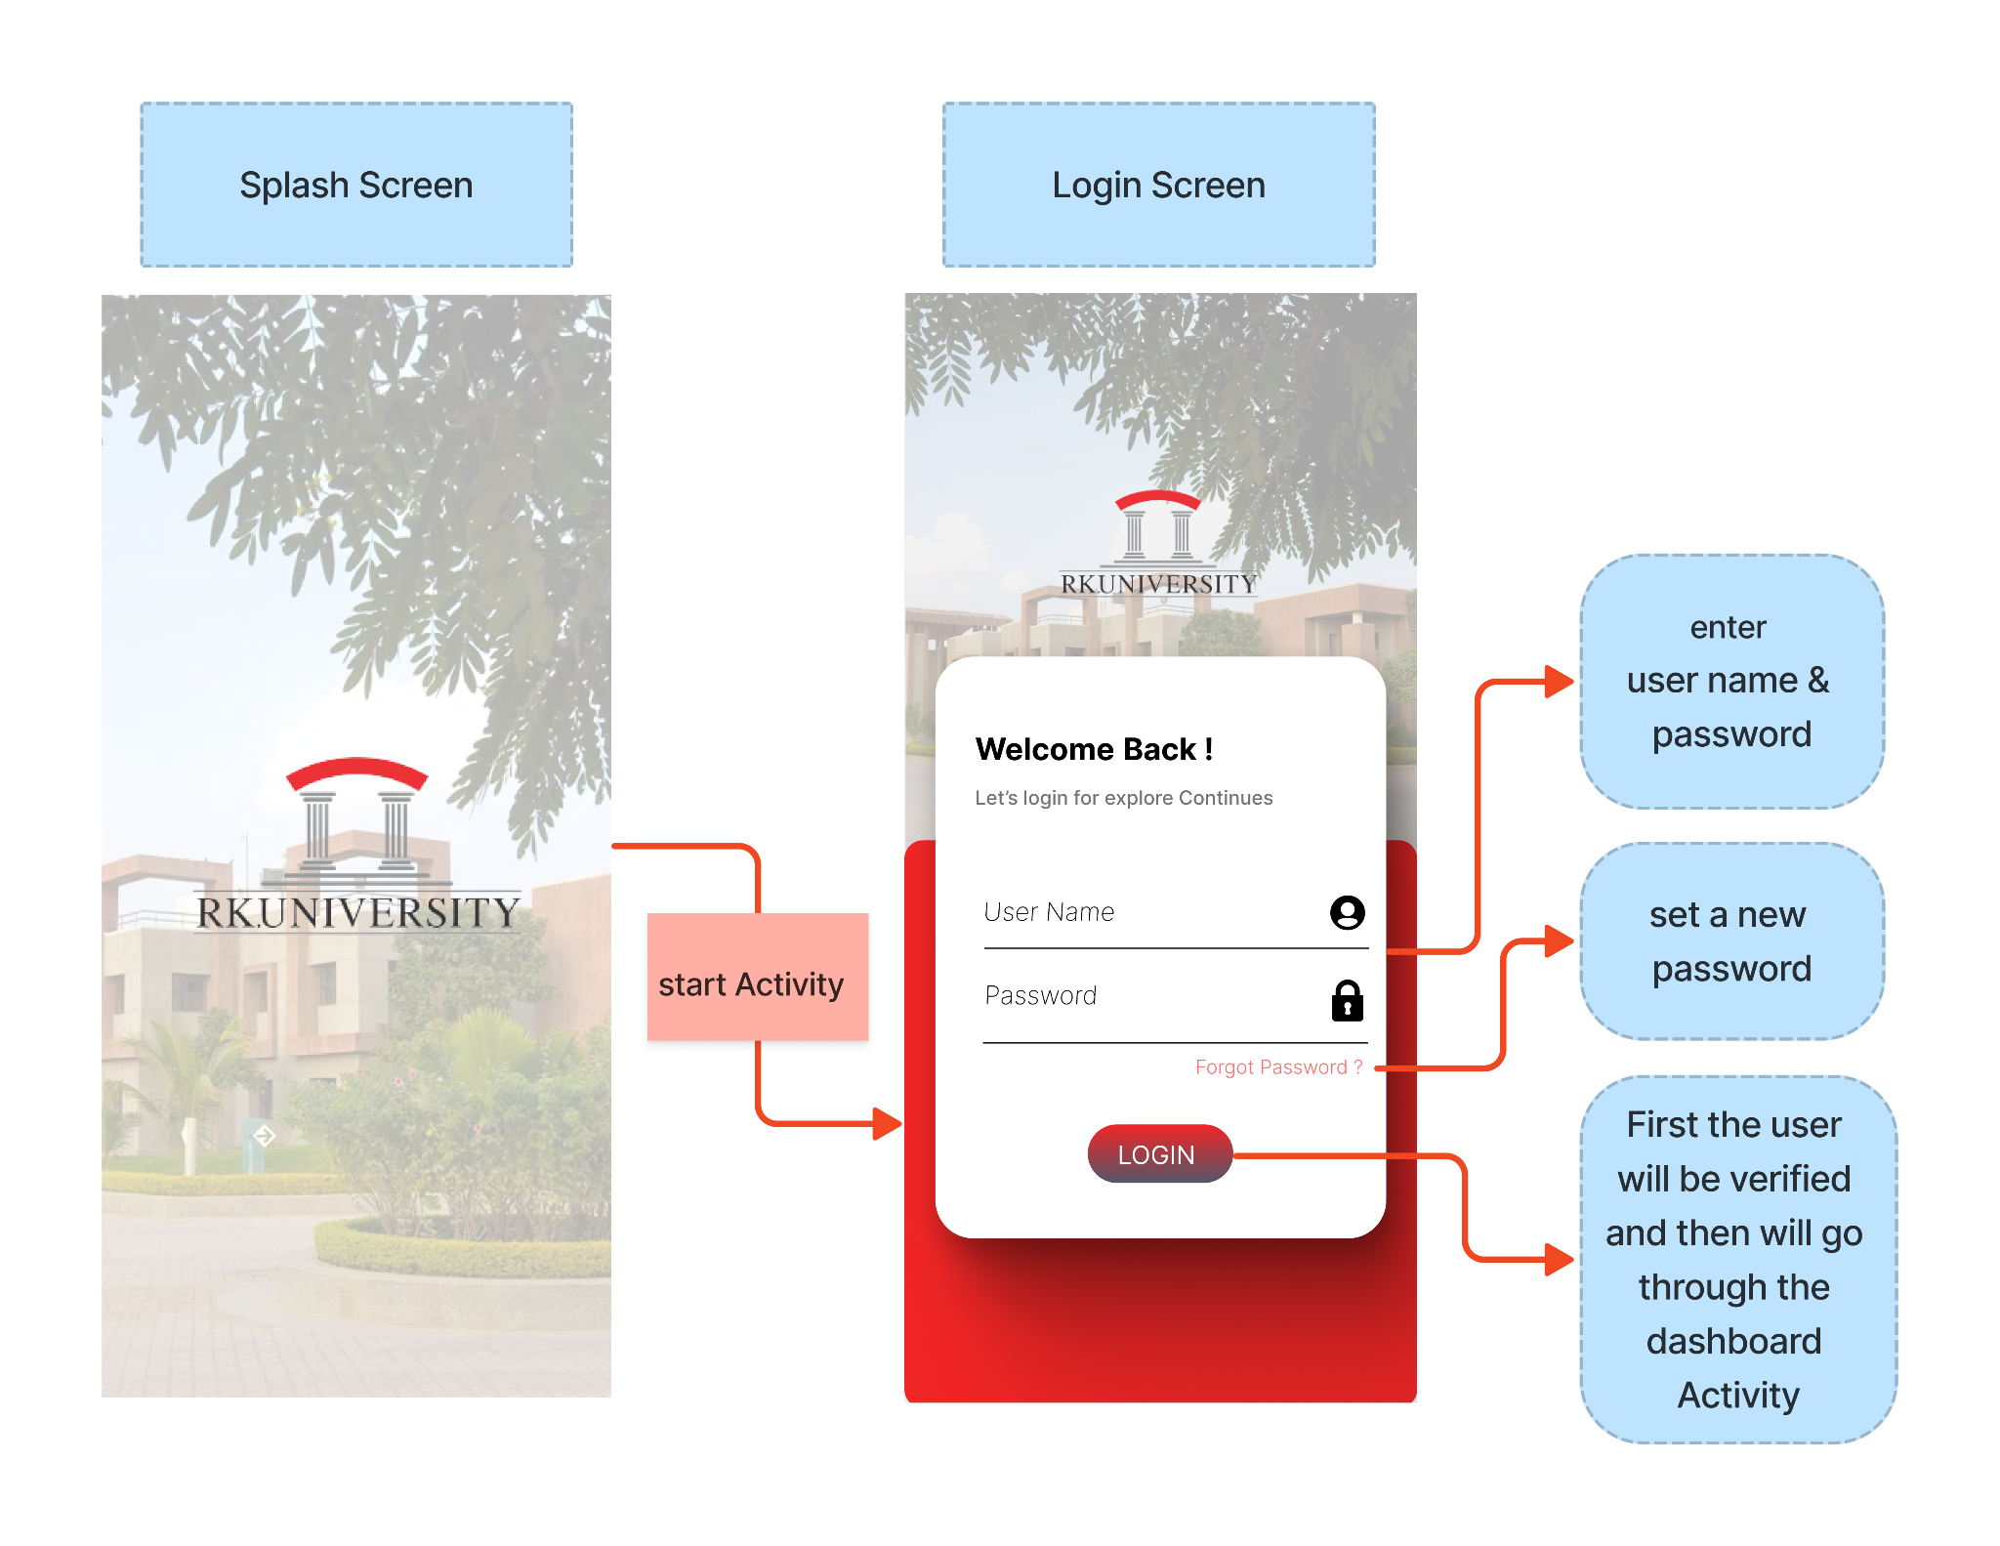

Slide 15
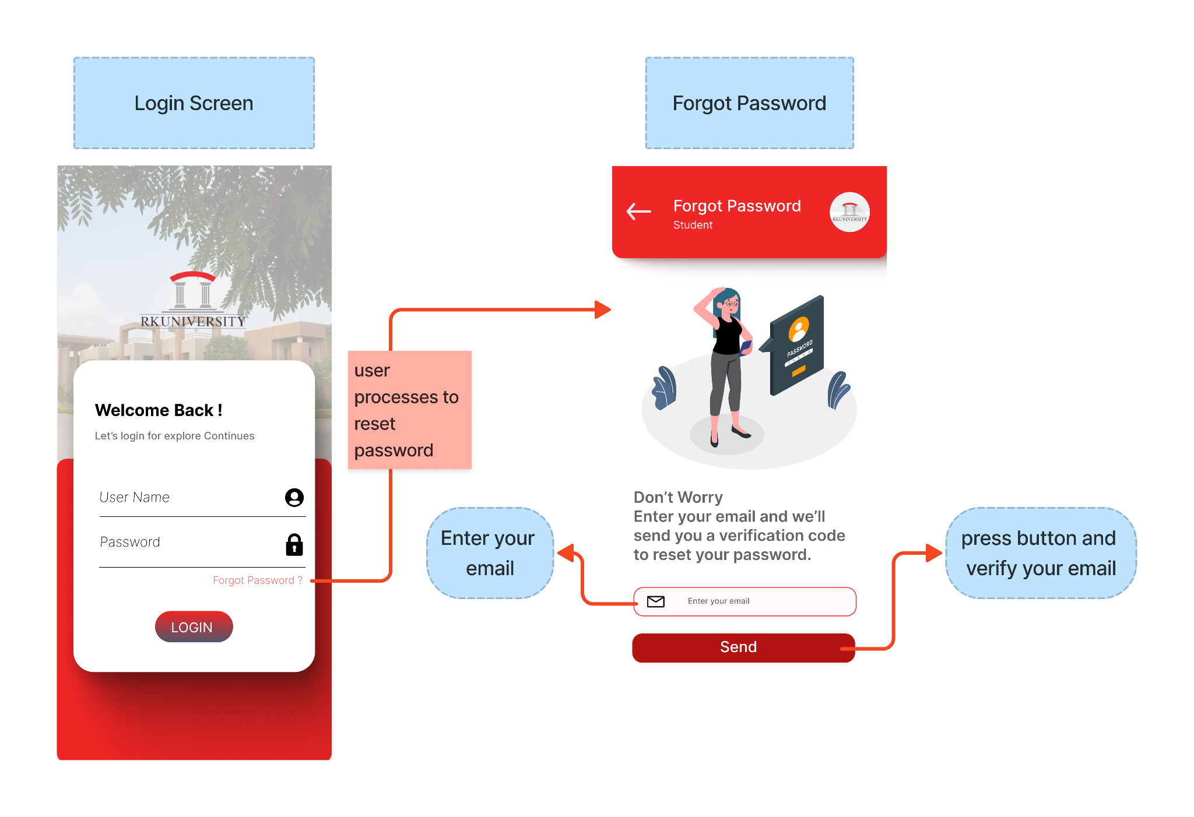

Slide 16
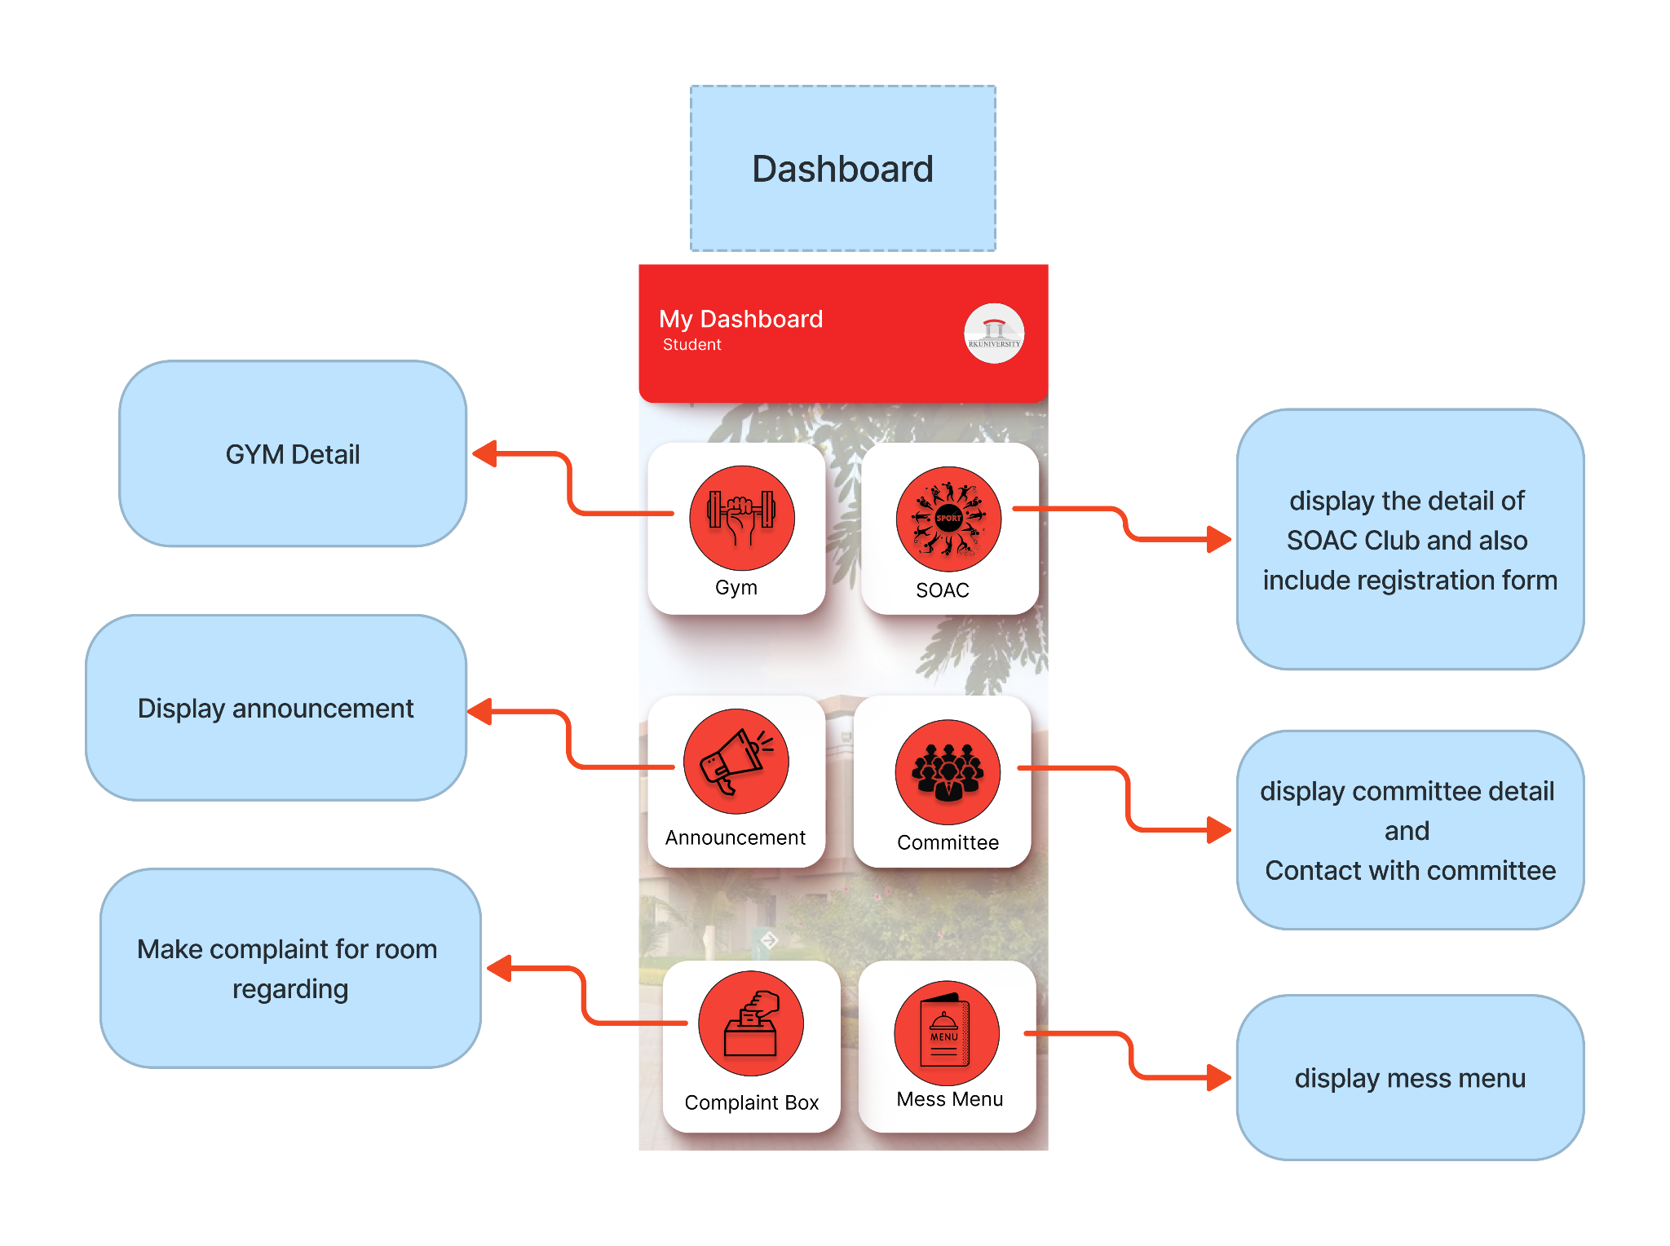

Slide 17
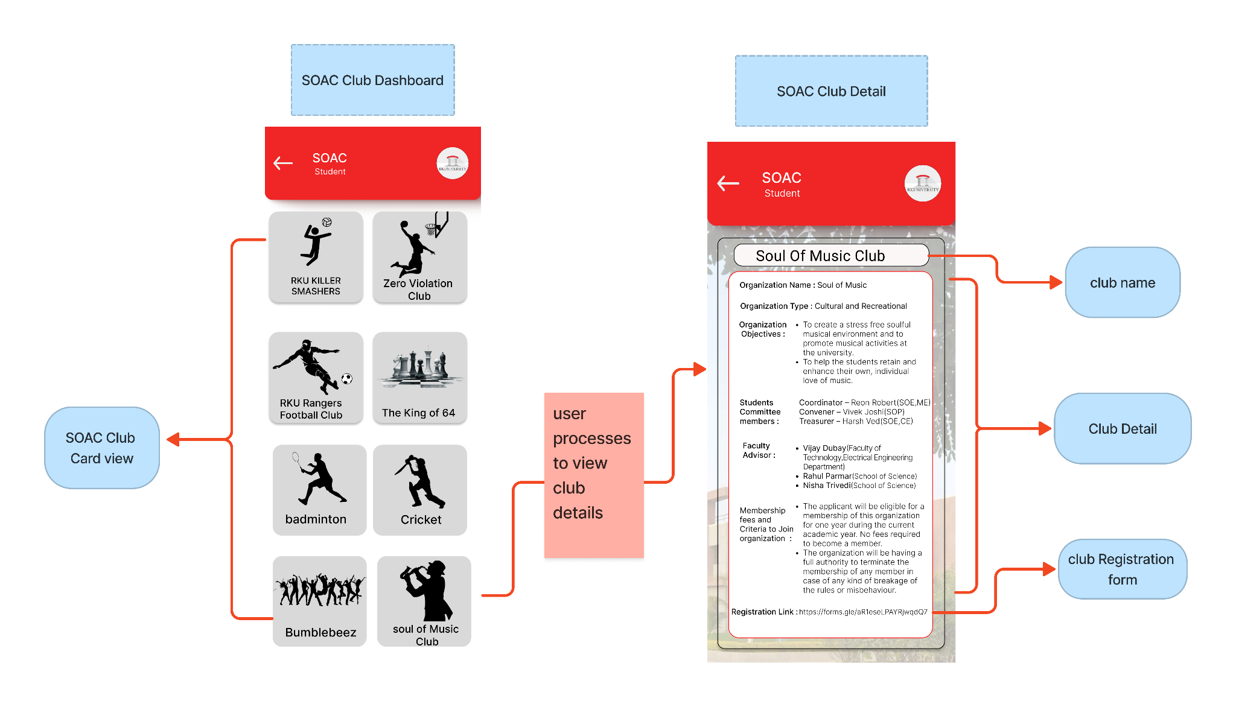

Slide 18
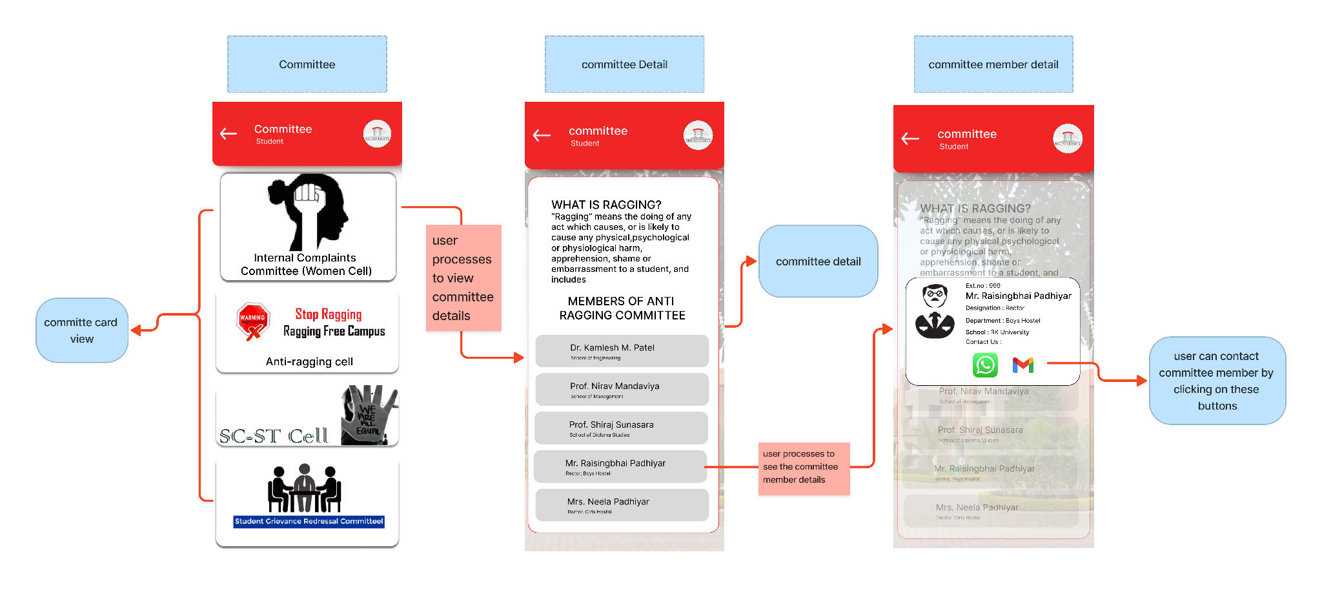

Slide 19
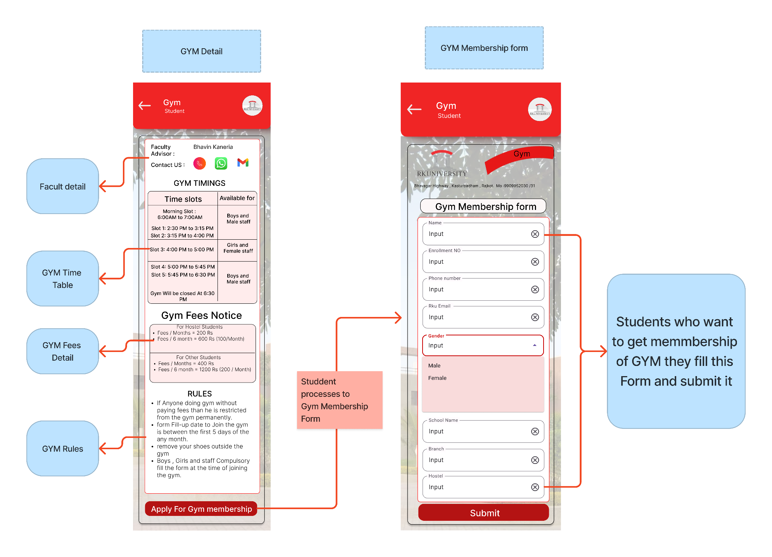

Slide 20
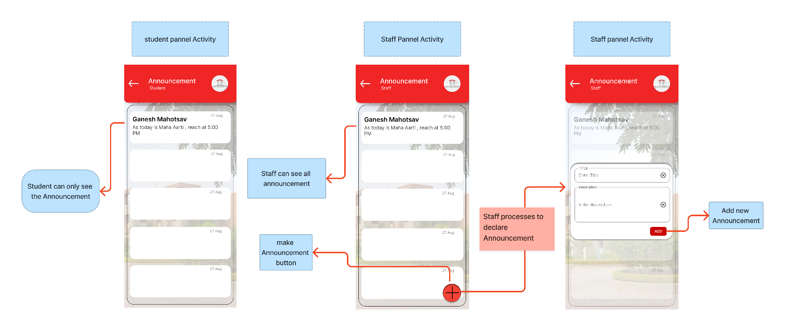

Slide 21
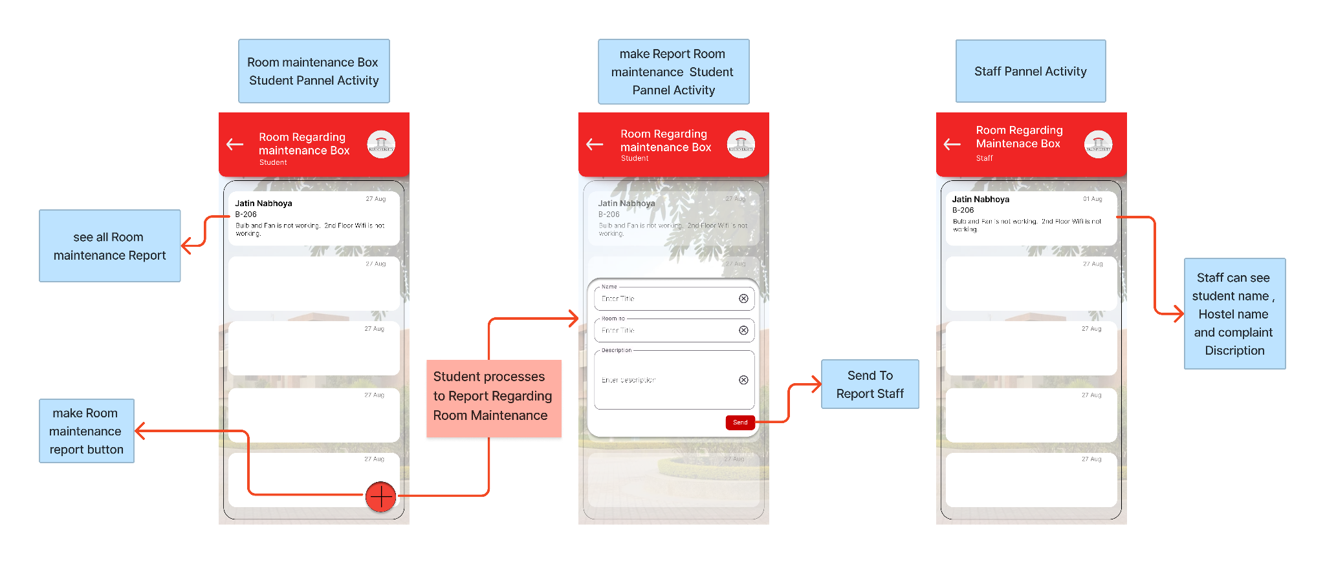

Slide 22
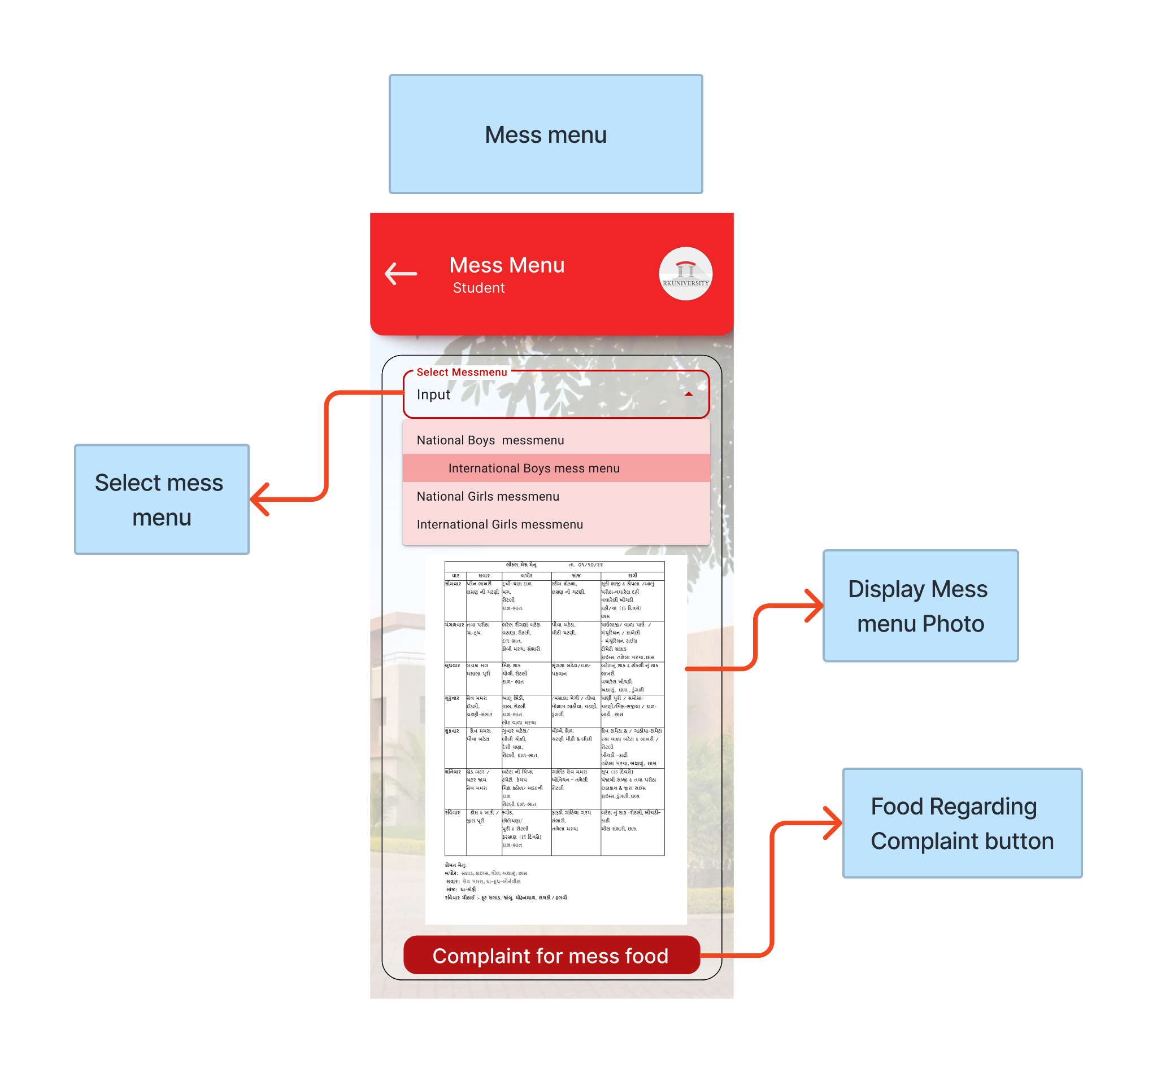

Slide 23
Diagrams

Slide 24
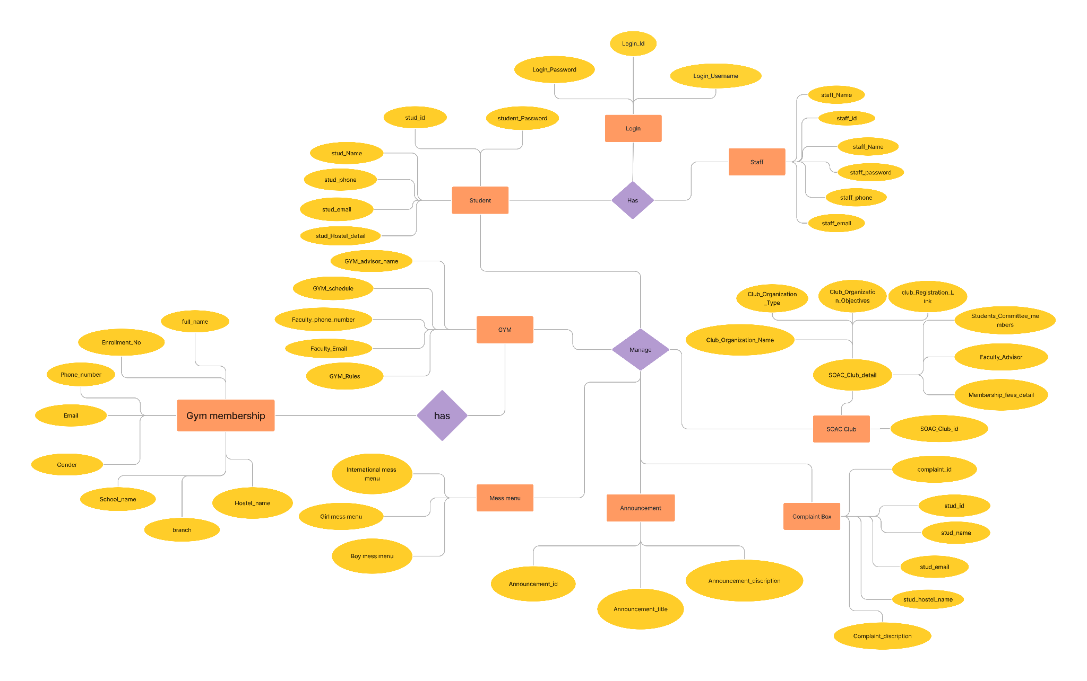
ER Diagram

Slide 25
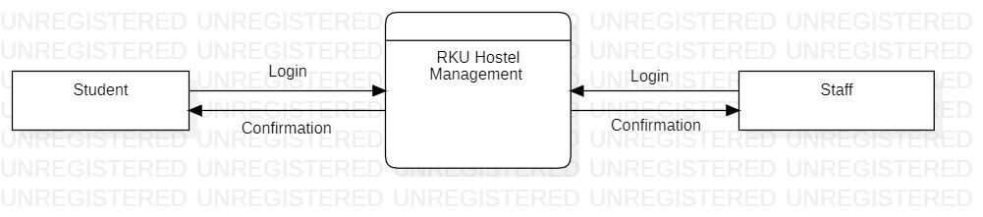
DFD level 0

Slide 26
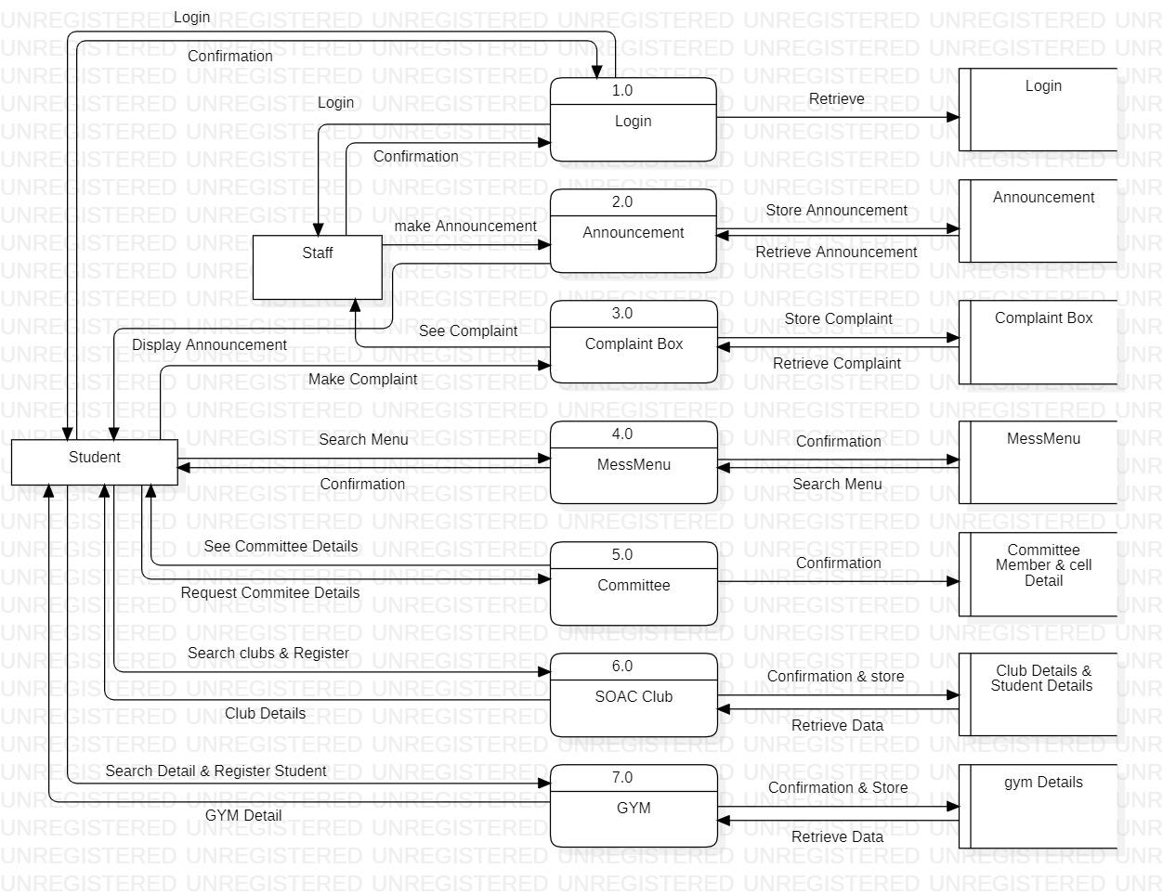
DFD level 1

Slide 27
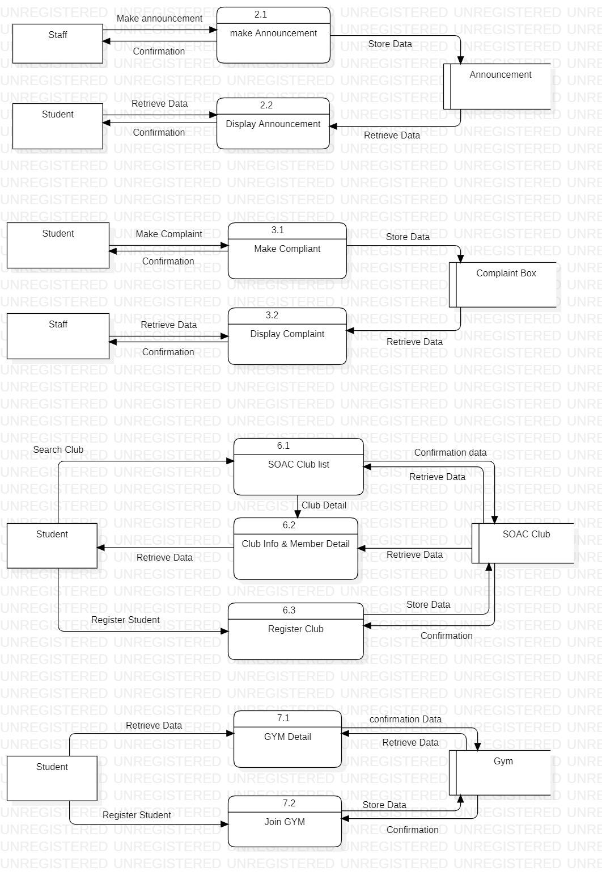
DFD level 2

Slide 28
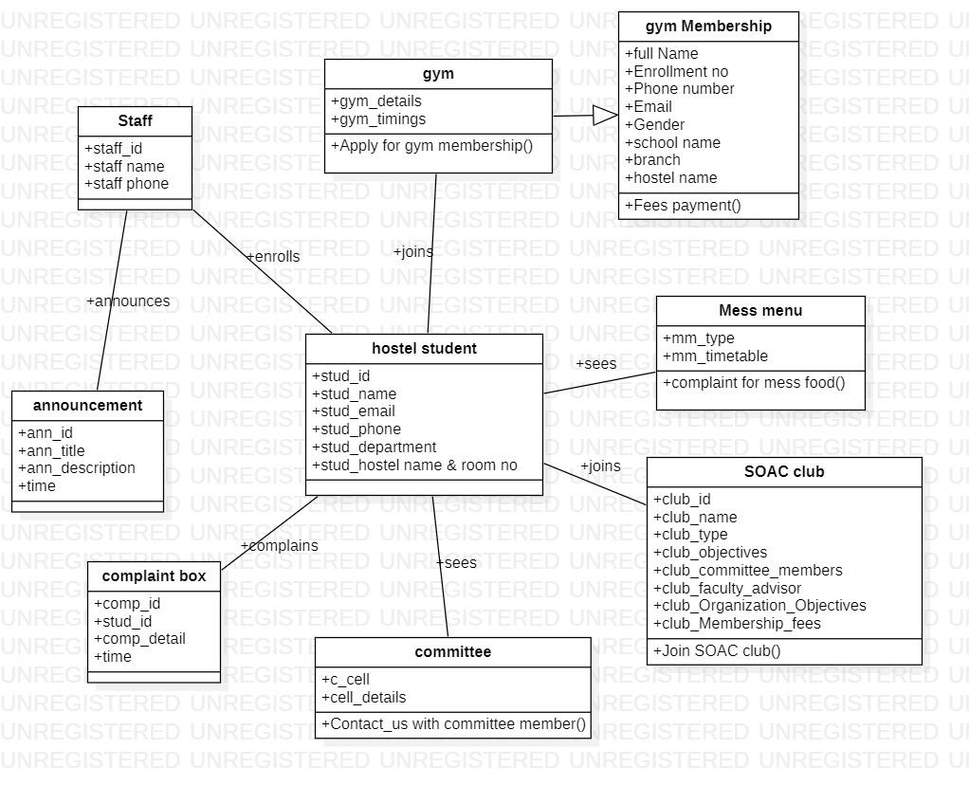
Class Diagram

Slide 29
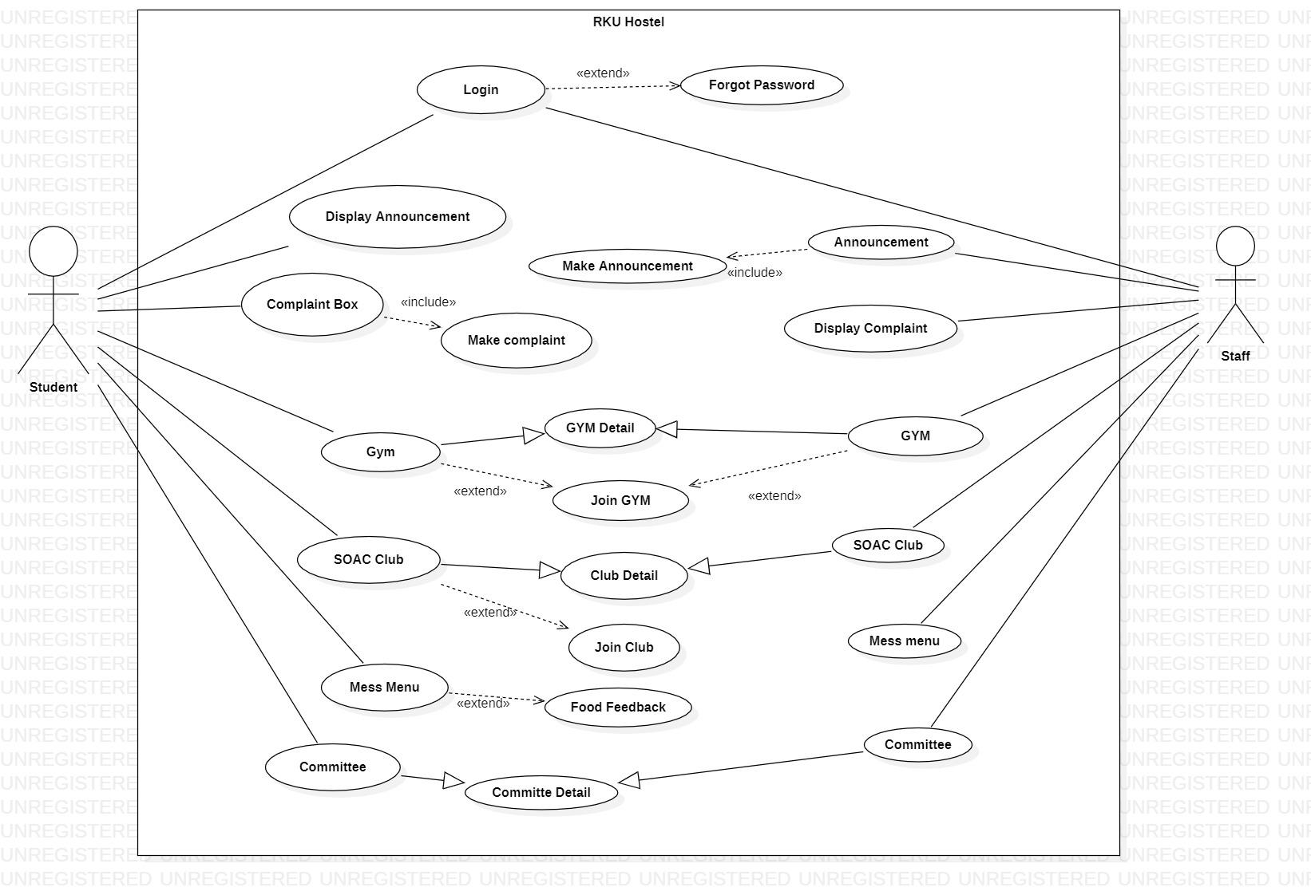
Use Case

Slide 30
Flow Chart

Slide 31
Future Enhancement
Hostel attendance
Gate pass
Staff panel
Student detail
Add/remove new student
Vacancy of room

Slide 32
Thank You

